Slide 1
Using reflection to get over the “untestable” code hump

Slide 2
About me
Jack Alvrus - AIS
Full stack developer, occasional architect
Automated testing evangelist

Slide 3
A conversation about testing
Adam: I’m working with an existing code base and I have a class I want to write tests for, but it calls HostingEnvironment.MapPath and I can’t find a way to mock that.
Jack: Just extract a wrapper class that calls HostingEnvironment.MapPath and inject it into the class you want to test.
Adam: But I don’t want to modify the class and risk breaking it just to write a test for it.
Jack: Fair point.

Slide 4
Why write tests for “legacy” code?
Legacy Code: existing code that is already in production; “untestable”
In general, don’t add developer tests without a good reason
But when you need to modify it, the calculus changes
Red, Green, Refactor
Confidence to refactor code to be “testable”
Confidence to modify the behavior without introducing bugs

Slide 5
So what’s the problem?
Current developer testing practices require code to be written to be “testable”
Code under test can be decoupled from its runtime environment and that environment simulated
Typically done using dependency injection and mocking
Legacy code often can not be decoupled from its runtime environment and/or its runtime environment can’t be simulated

Slide 6
So what’s the solution?
Commercial mocking frameworks that can modify compiled code at test time
“Shims” in Microsoft Fakes
TypeMock Isolator
Telerik JustMock
These are commercial products that require a license, so they may not be available to you.

Slide 7


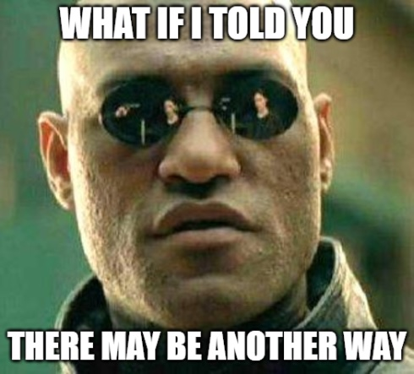

Slide 8
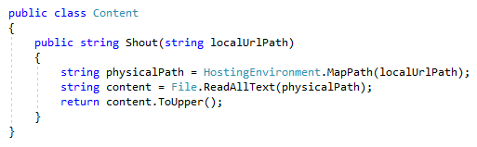
Legacy Code to test
MapPath converts /foo/bar.txt into c:\wwwroot\site\foo\bar.txt
Peek at the code
Poke at the state

Slide 9
PeEking at the code
Decompiler
ILSpy - https://github.com/icsharpcode/ILSpy/releases
Microsoft Reference Source
.NET Framework - https://referencesource.microsoft.com/

Slide 10
Poking at the state
Reflection can be used to access non-public members
Read and write fields or properties
Execute functions
Instantiate types

Slide 11
Time to write some code!
Write enough tests to support refactoring
Refactor for testability
Write further tests to assert all desired behavior

Slide 12
Drawbacks
Difficult (or impossible) and time consuming to do
Possibly subject to code security (security-critical members not accessible)
Tightly coupled, fragile
Resulting code is hard to read (depends on external code)

Slide 13
Benefits
May help you get un-stuck
Reflection is another tool in your kit
Please use responsibly
Deeper understanding of .NET
This approach to refactoring legacy code can be applied with commercial mocking frameworks

Slide 14
Done
Questions? Comments? Lauds? Flames?

